Slide 1


Alpha Phi Omega
Chi Chapter at UCLA
Alpha Lambda / Yuna Choi Term, Meeting 7
May 14, 2014
www.apo-x.org

Slide 2
Agenda
1. Officer Updates and Announcements
2. Chapter Business
3. Last Announcements

Slide 3
President
Jessica Suhardjo
president@apo-x.org
Executive Committee
excomm@apo-x.org

Slide 4
Administrative VPs
Joseph Chan & Nicola Yip
admin@apo-x.org

Slide 5

Updates
Line viewer integrated with roster
WiCHIpedia hacked again
Alumni, please sign up for Alumni Networking Night!

Slide 6
Membership VPs
Jeremy Gozzip & Melissa Ma
membership@apo-x.org

Slide 7
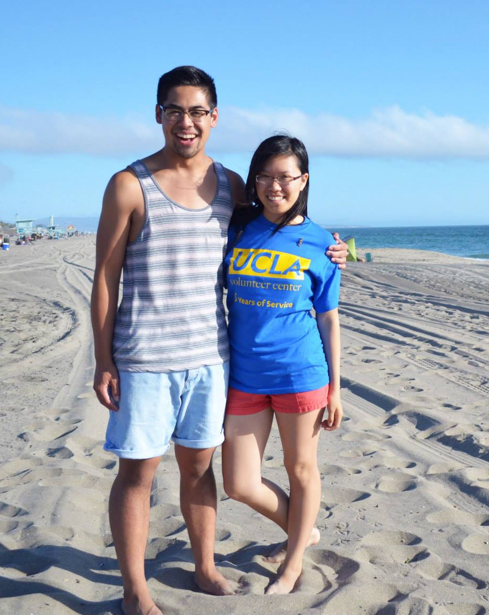
Chapter Bonfire!
Thanks for coming!
Special Thanks to:
Paul Choung- for bringing volleyball stuff, cooler, radio, and table!
Emily Neai-Proeung- for buying more firewood for us!
Jessica Suhardjo- for buying more ice/bringing Paul’s cooler!
Abelard Bautista- for letting MVPs use your cooler!
Dianne Pham- for bringing soda/utensils/etc.
Annie Tran- for the condiments!
Brandon Liauw- for helping us MAKE FIRE.
AND thanks to
Dianne Pham, Jun Li, Abelard Bautista, John Young, Paul Choung, Jeron Tan, Catherine Teotico, San Li, Joseph Nguyen, Samuel Nganga
for driving!

Slide 8
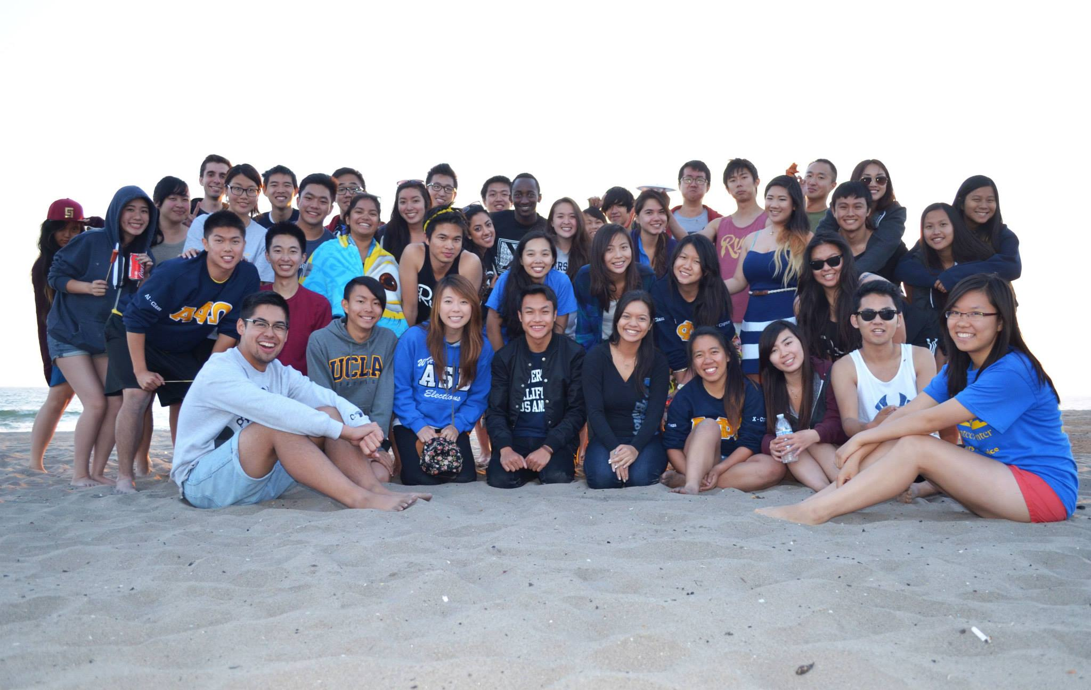
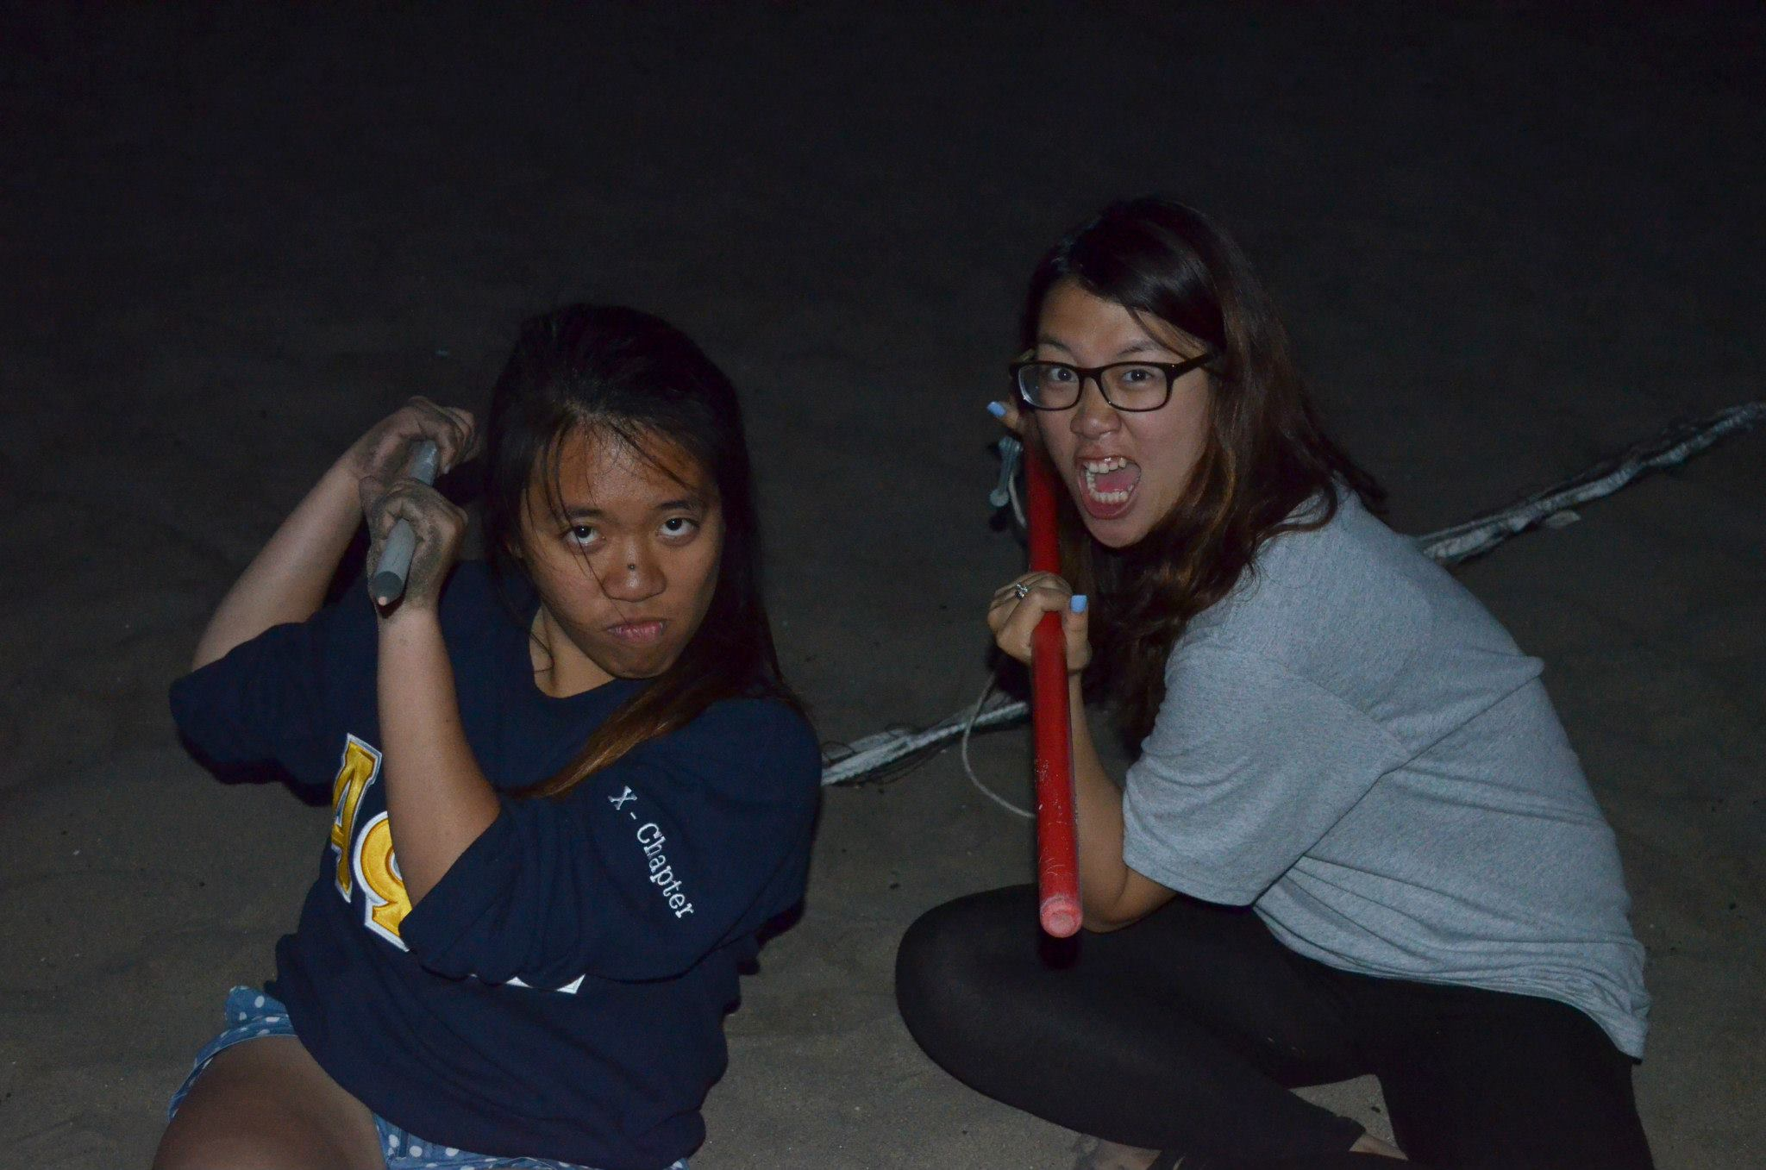
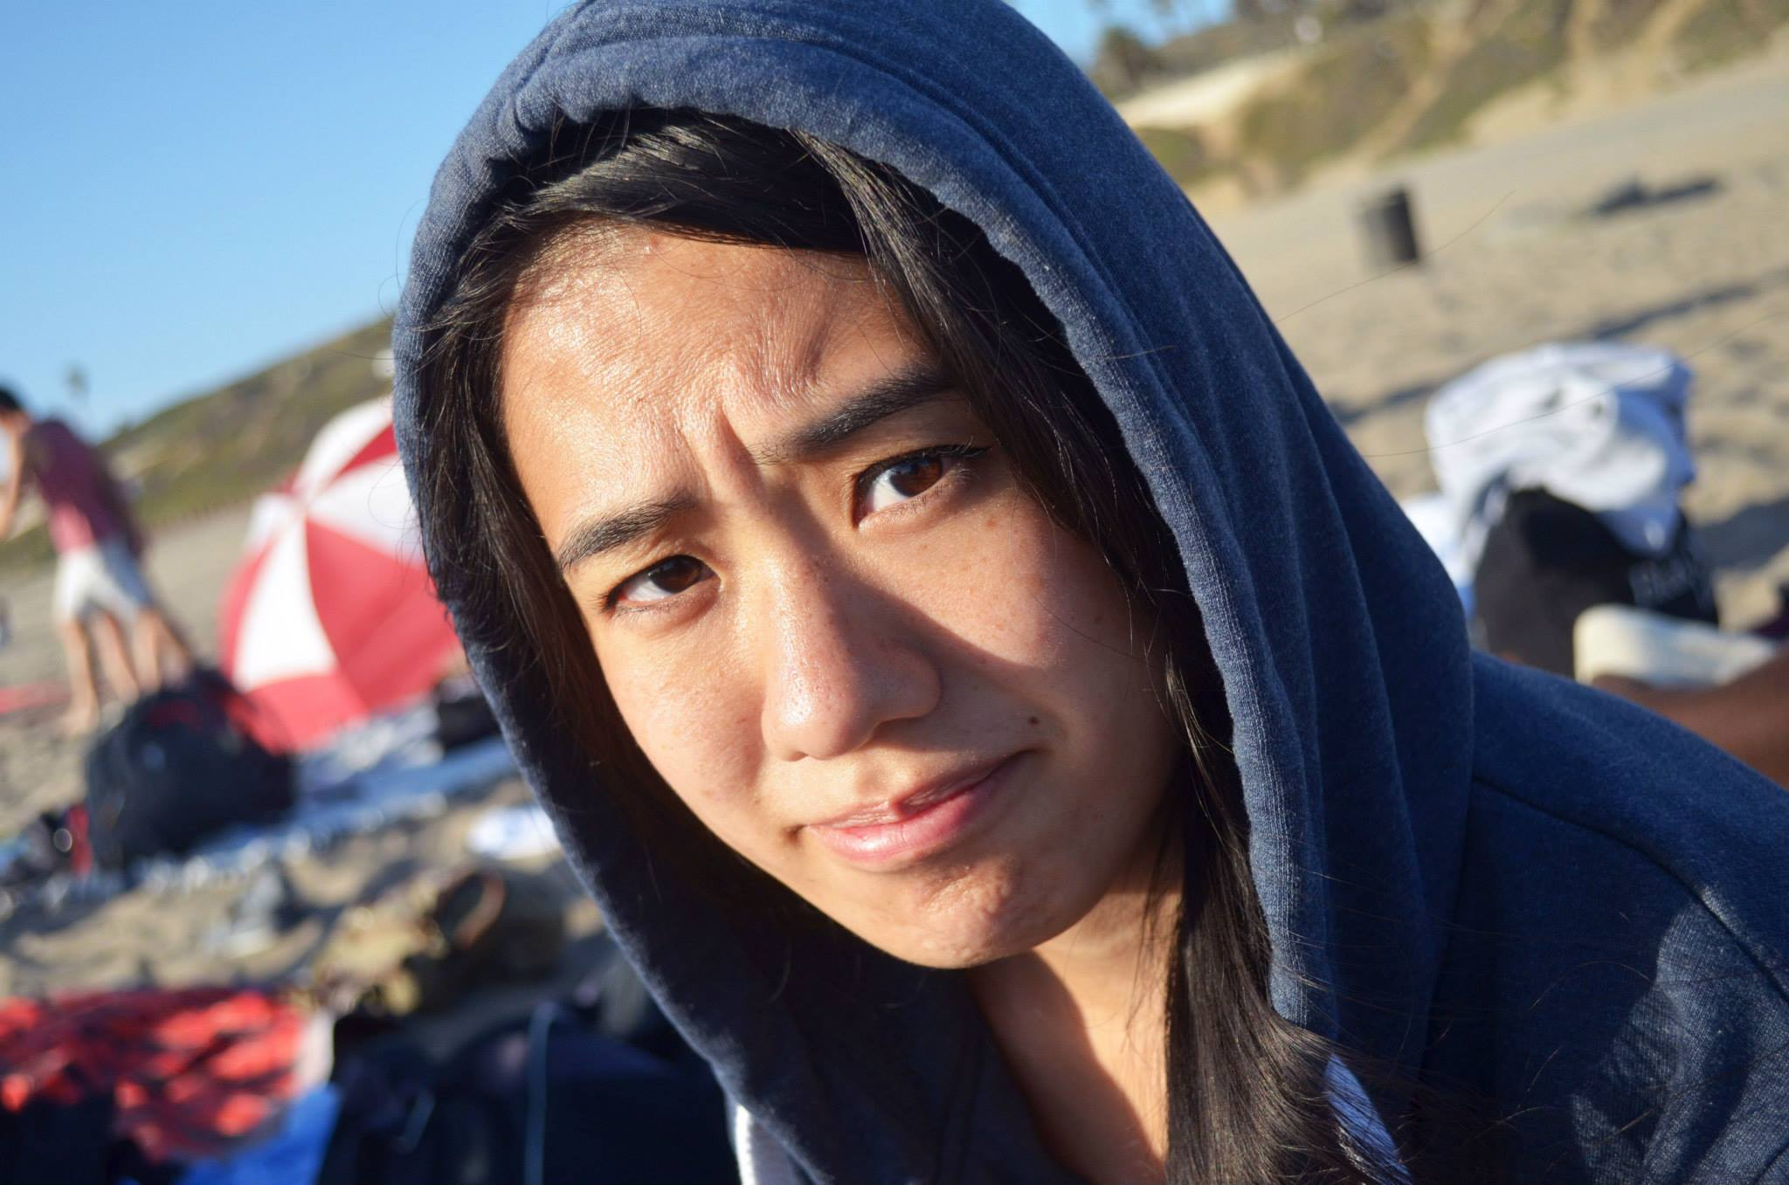
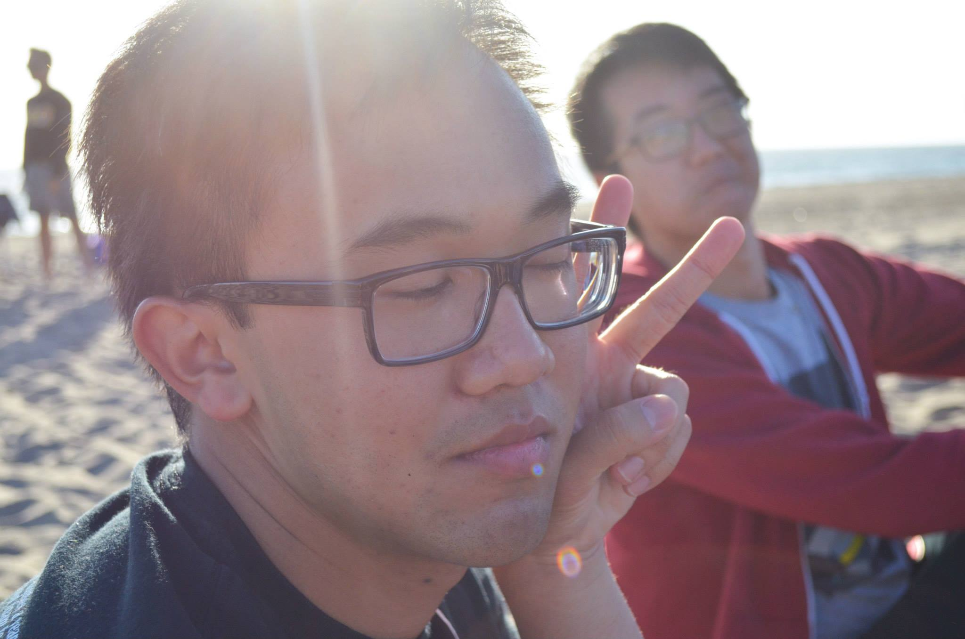
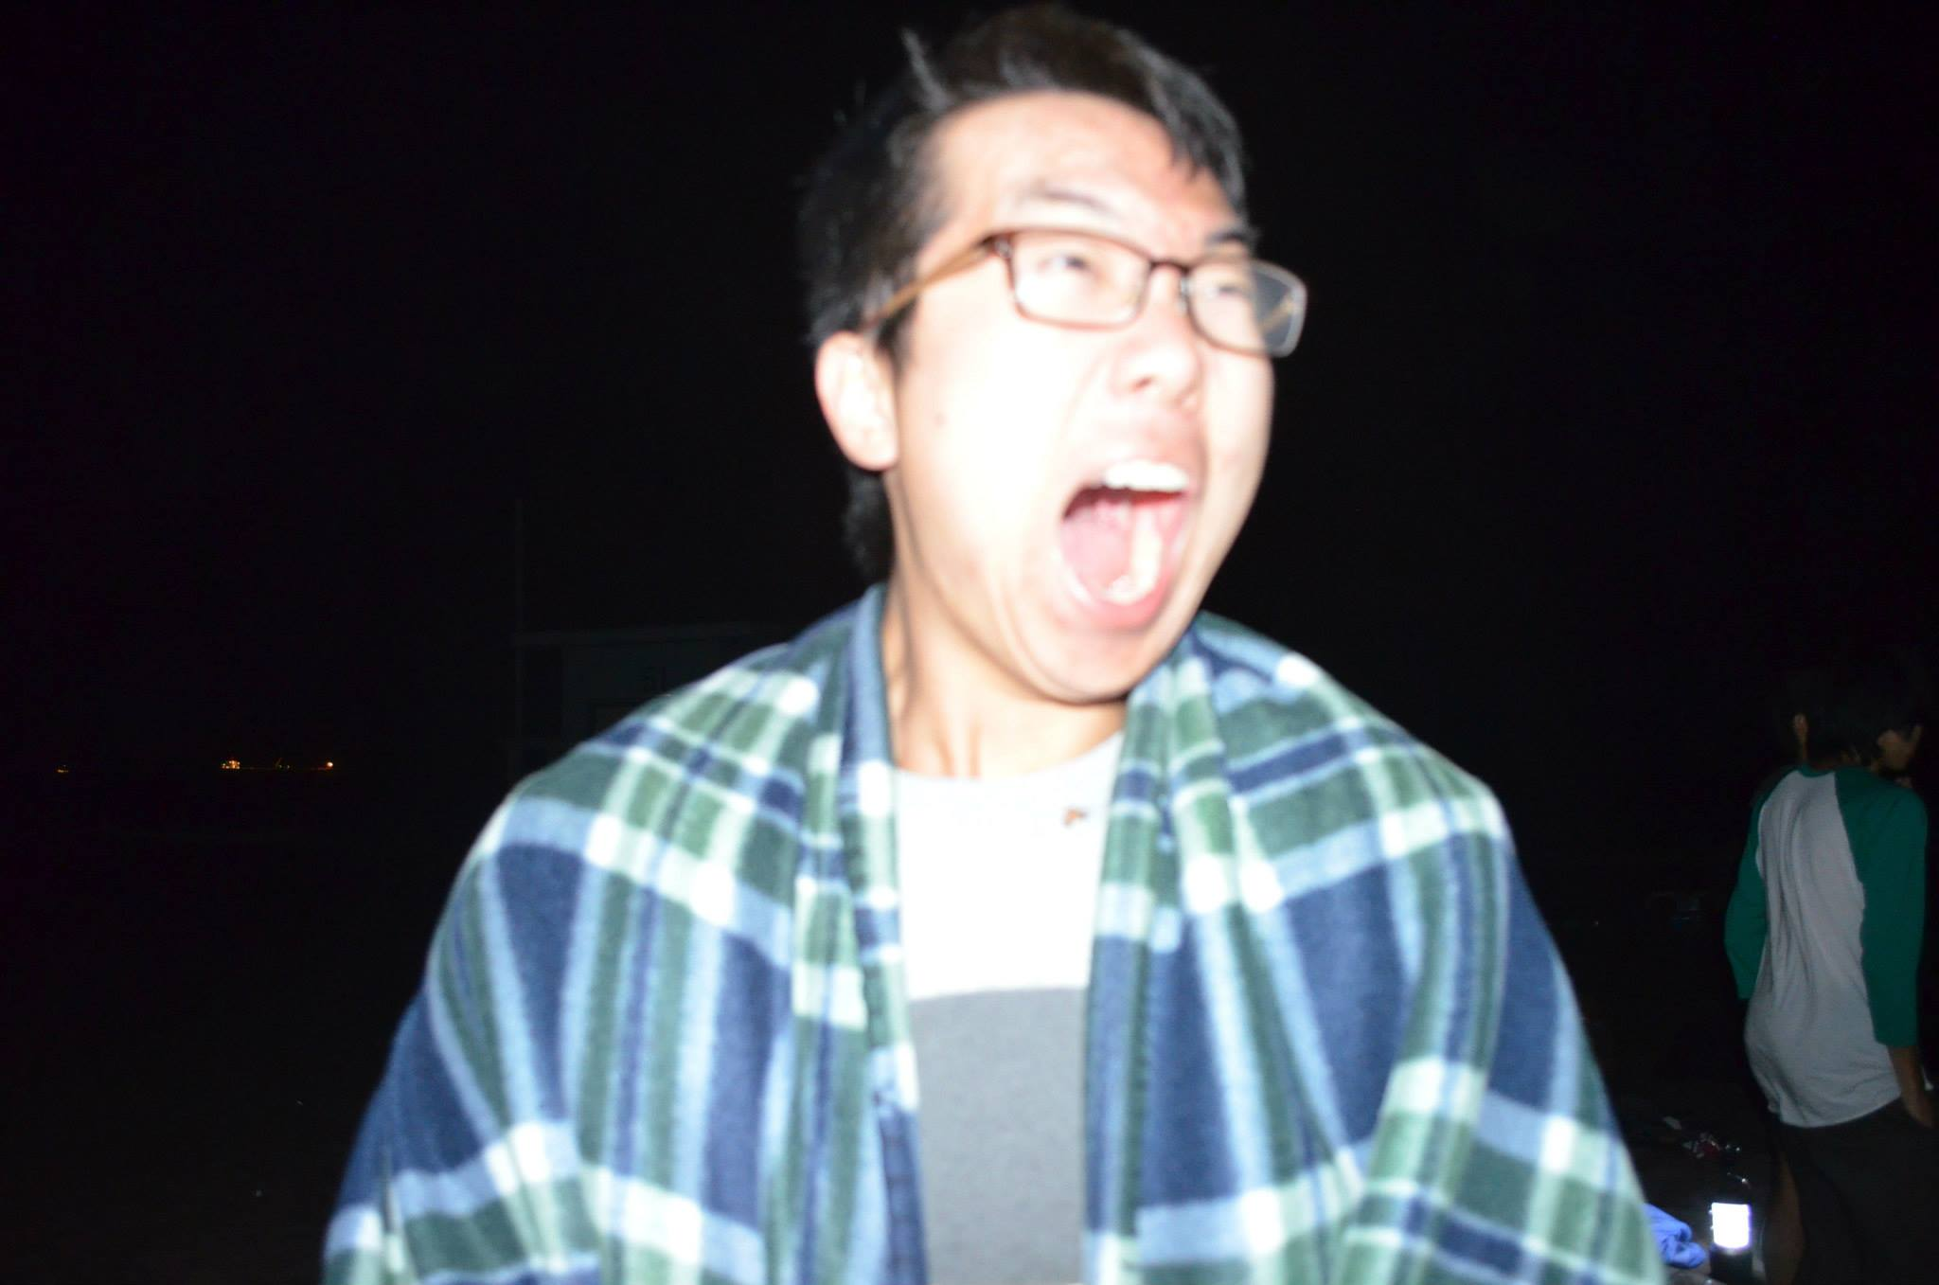
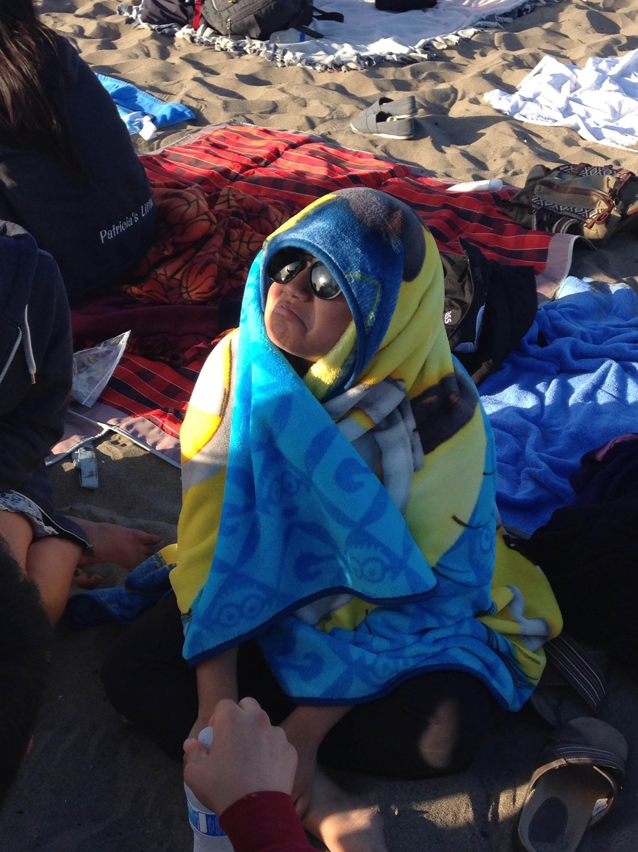
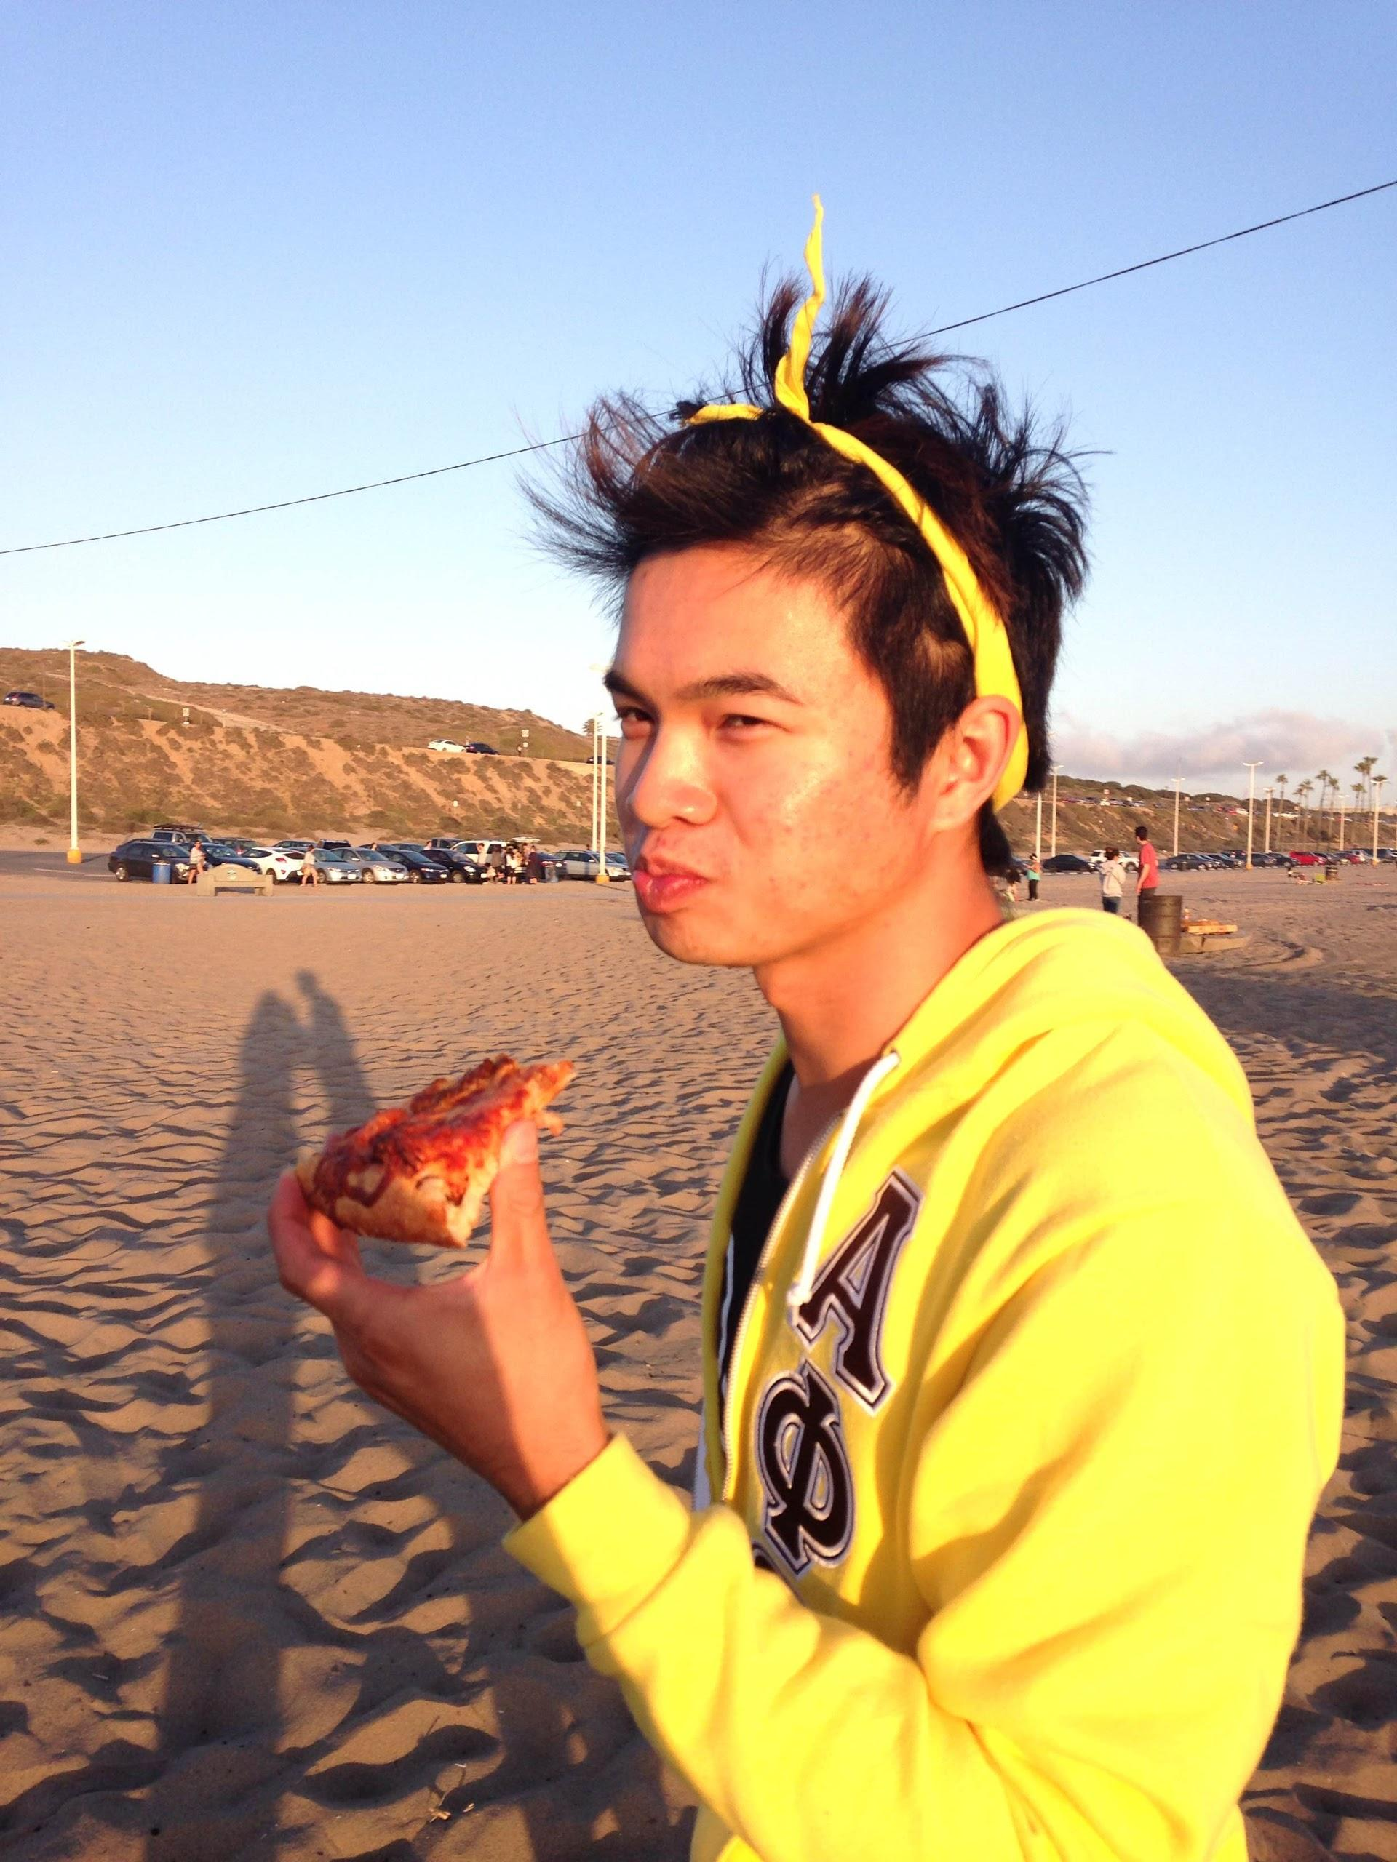
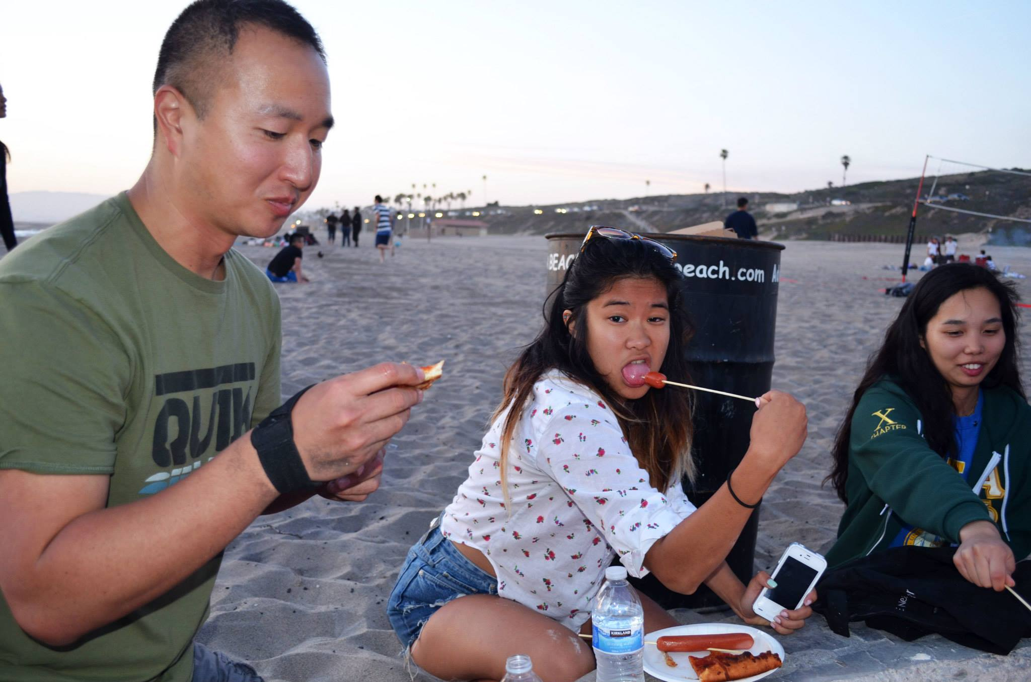
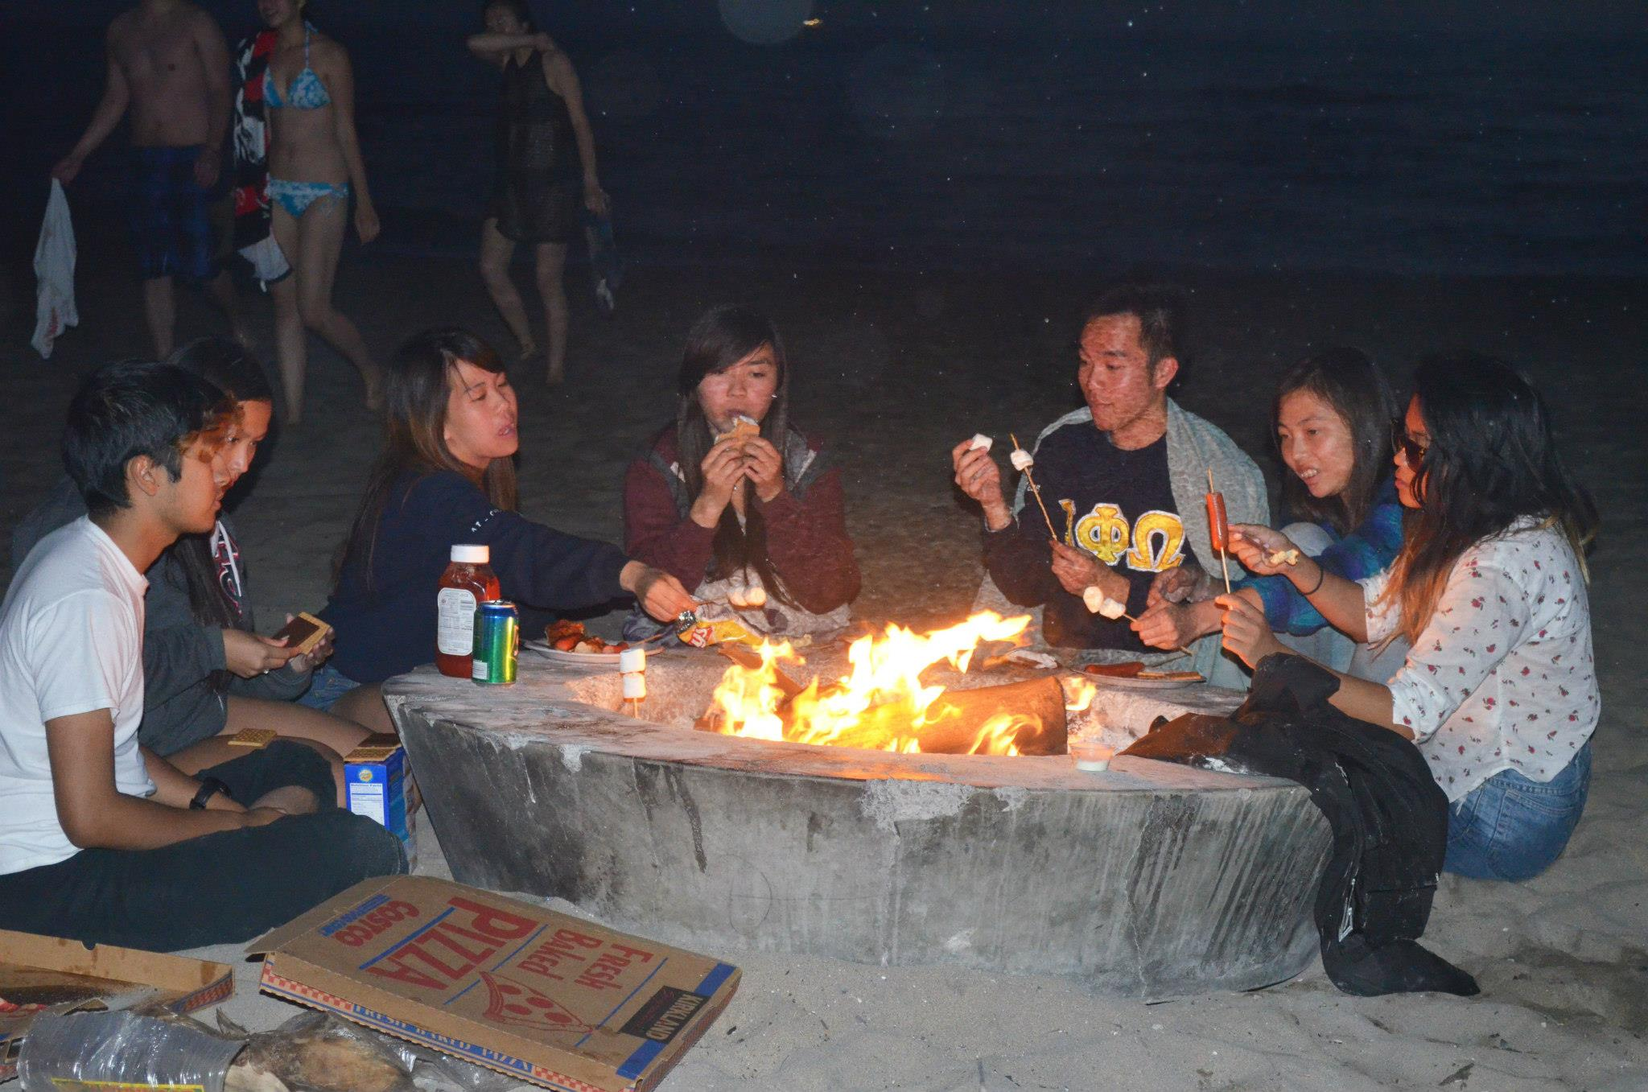
Chapter Bonfire!

Slide 9

Upcoming Chapter Events
5/18 Activation
5/21 Chi-Trivia Night
5/24 Benefit Concert

Slide 10
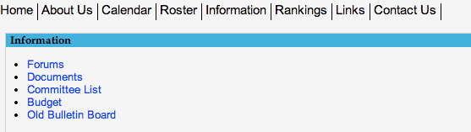

Golden Eagle Nominations!
Submit your nominations before 5/15, 11:59PM!
Keep the nominations coming! :]
Please nominate GOOD-STANDING ACTIVES
PLEDGES YOU CAN NOMINATE PEOPLE TOO!
URL: http://www.apo-x.org/forums/read.php?4,4650

Slide 11
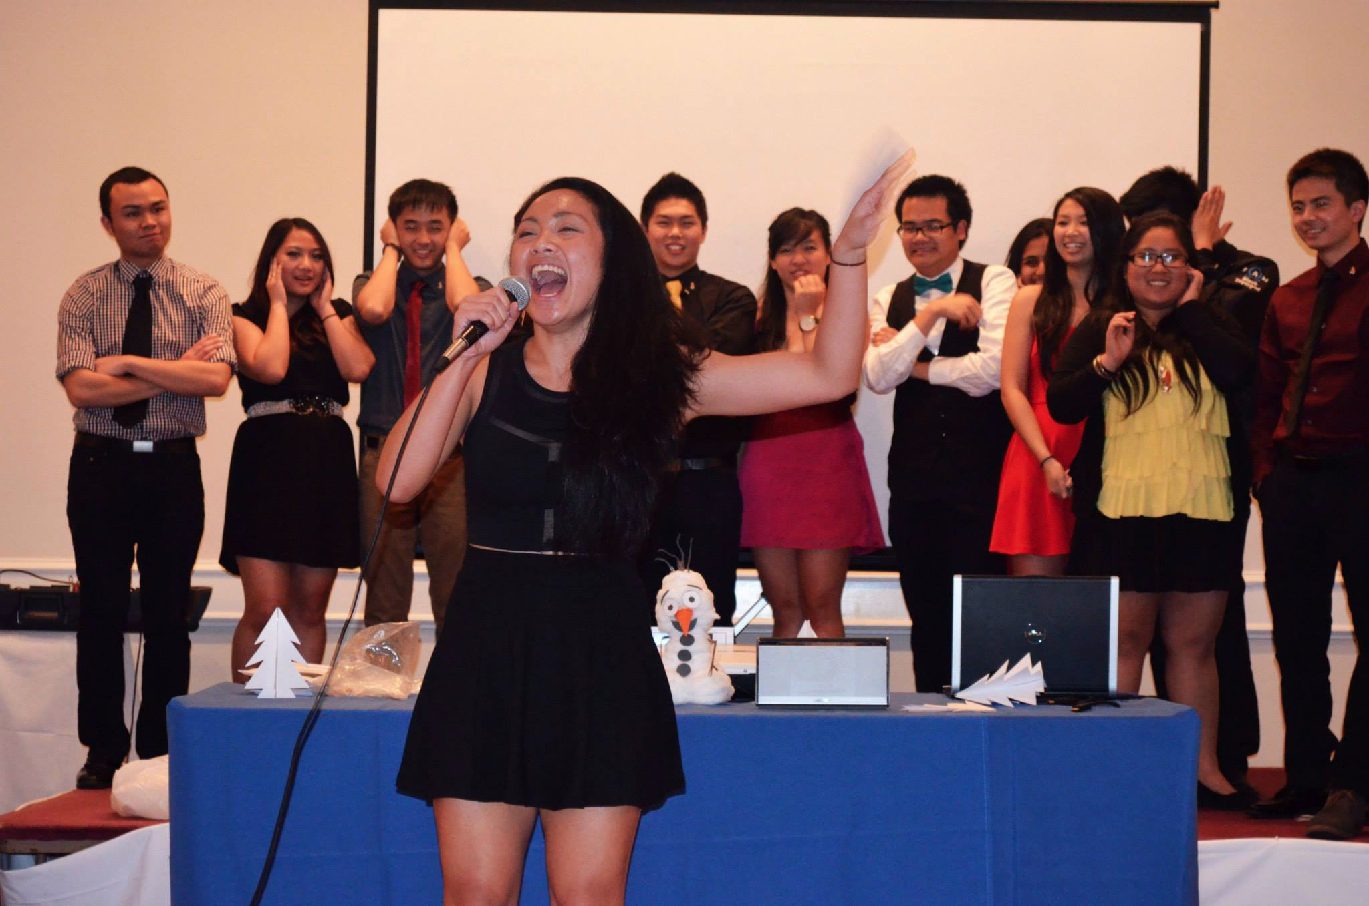
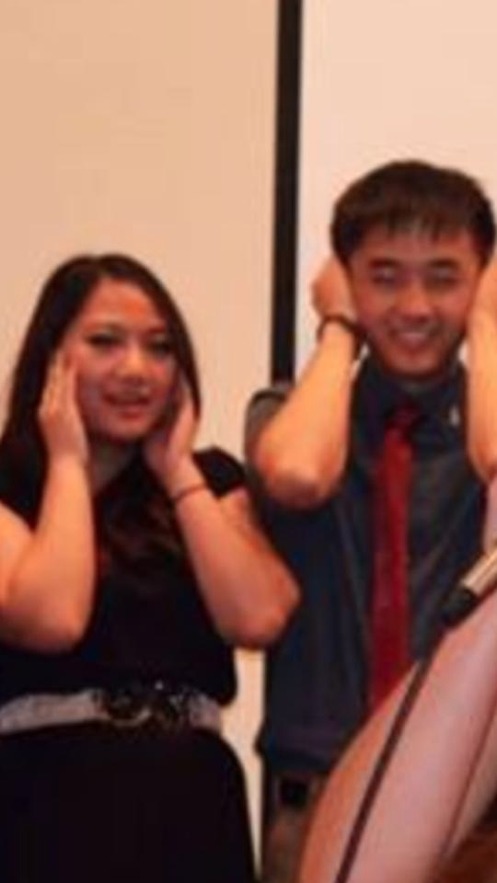
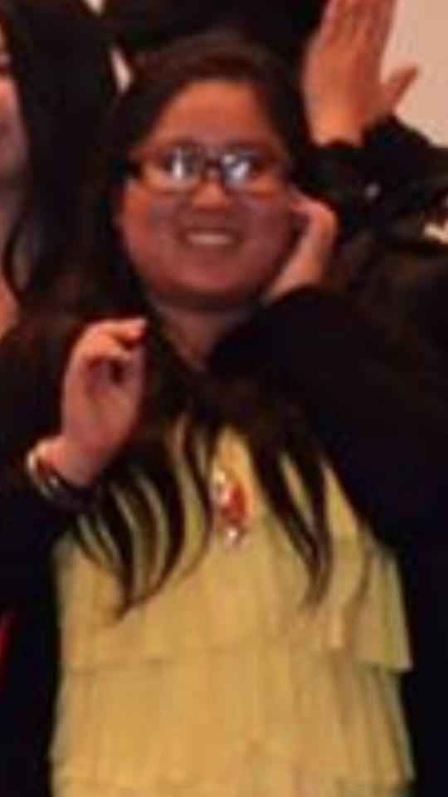
Golden Eagle Nominations!
*BEHOLD: The cry of the rare Filipino Golden Eagle

Slide 12
LFS and EMH
Vote for your LFS and EMH awards!
For LFS, vote for one Active and one Pledge in each category (L, F, and S)
EMH vote for one Active brother

Slide 13
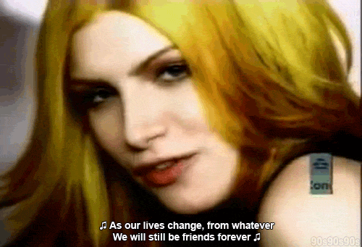
Senior Memories Night!
Wednesday, May 28th
after CM 8
@ Kinsey 1200B
E-mail us if:
you are a graduating senior and are attending/Banquet/want to be spoken for
if you plan on speaking for a senior at SMN or Banquet

Slide 14
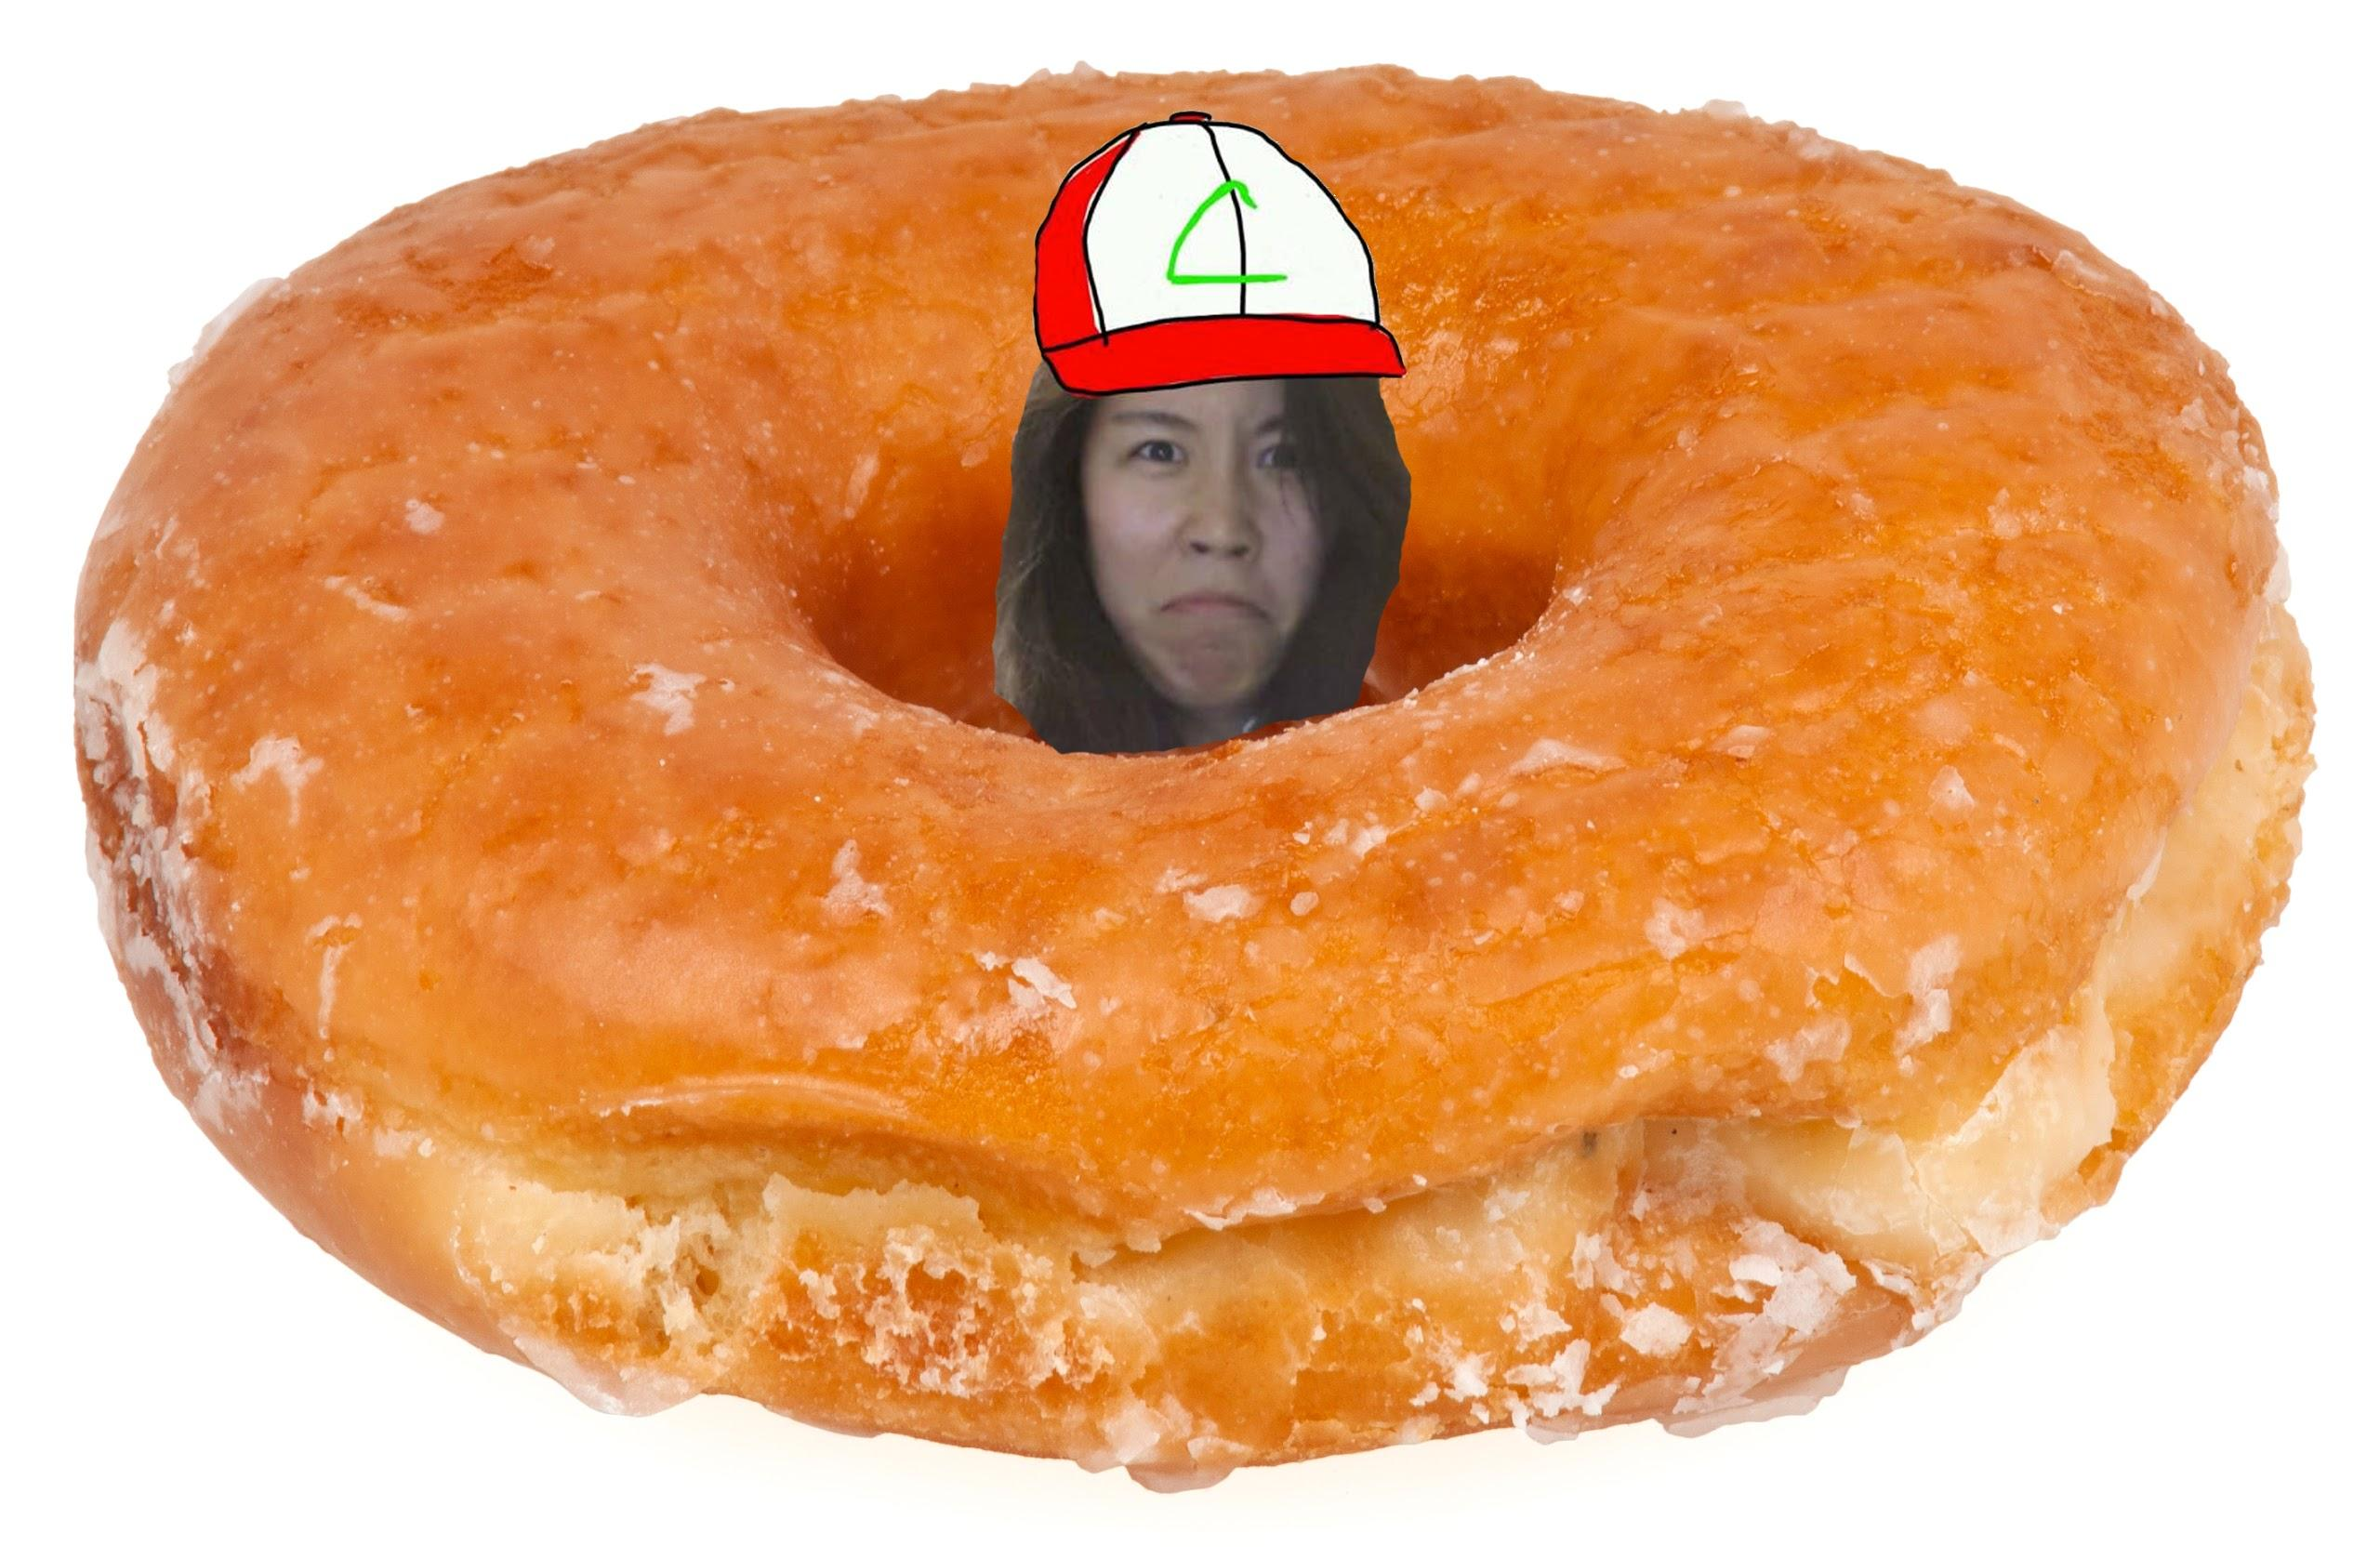
Shoutout Book!

Slide 15
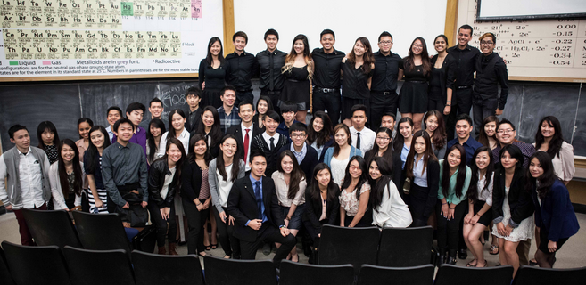
Alpha Lambda Achievement
ALMIGHTY LEOS
take a picture of 2 people in your family recreating the iconic pose from the Lion King in which Rafiki holds up baby Simba.

Slide 16
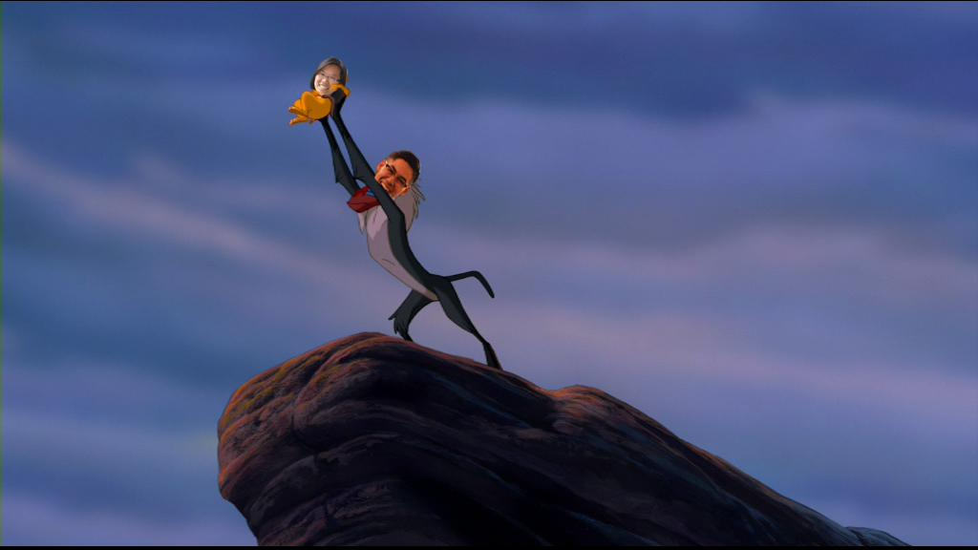
Alpha Lambda Achievement
ALMIGHTY LEOS
take a picture of 2 people in your family recreating the iconic pose from the Lion King in which Rafiki holds up baby Simba.

Slide 17
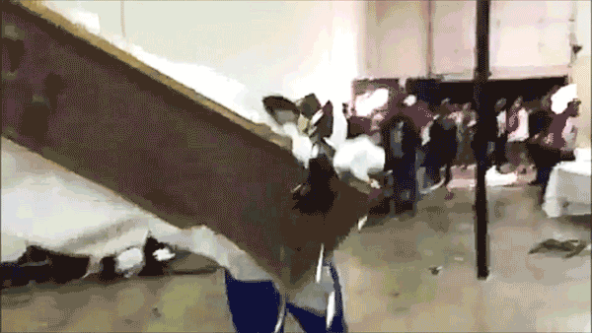
Achievements
ALL are due by May 24th at midnight.
WHICH FAMILY WILL WIN?!
GO GO GO!

Slide 18
Service VPs
William Nguyen & Jade Vo
apoxservice@gmail.com

Slide 19

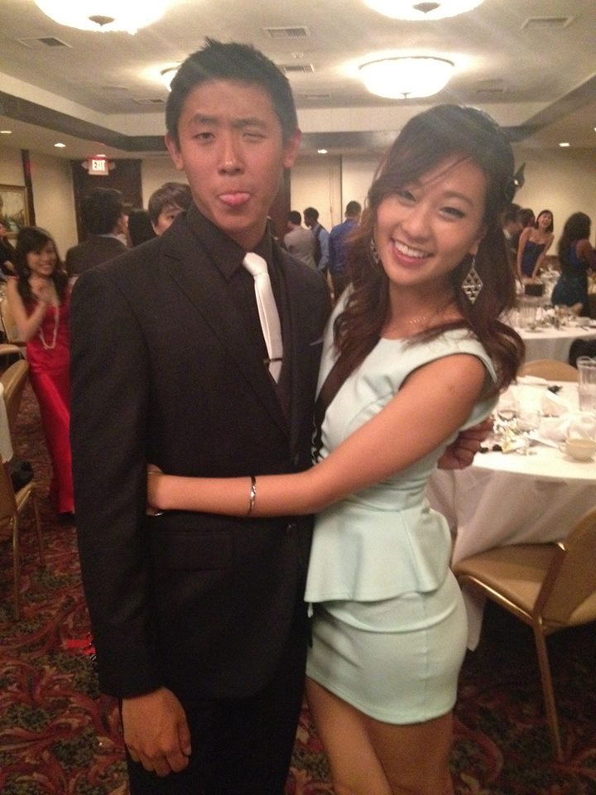

Concert Updates!
Flyering Shifts are up!Seriously finishing hours could not be easier...
Flyers printed!
TICKETING SET!
Performers: LINEUP SET!
MCs SET!
THANKS PAUL!SOUND AND FOG MACHINE YAS

Slide 20
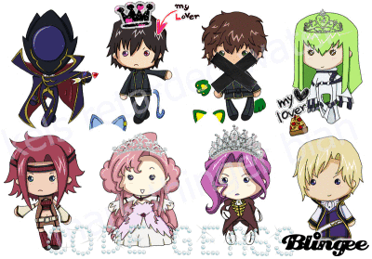
Other Updates!
NEW EVENTS UP!
Friendship Bracelets!
DUE DATES:
Pledges: W, 5/14 7PM Actives: W, 5/21, 7PM
SIGN THE HELL UP FOR EVENTS GUISE

Slide 21


SBotW!
This week’s SBotW is…
(drumroll please)

Slide 22
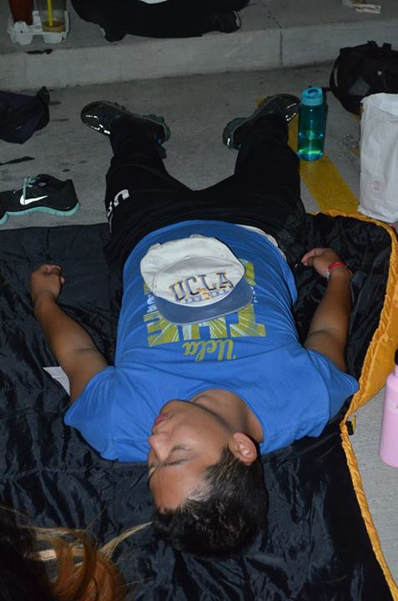

ALEX KIM!

Slide 23
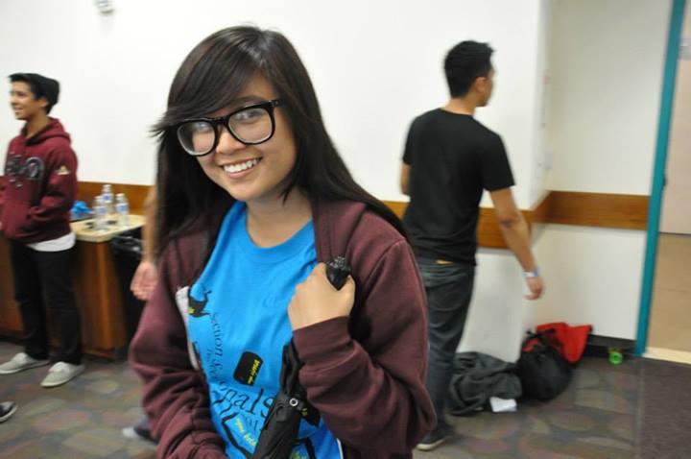
Julie Nguyen

Slide 24
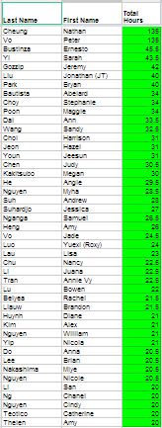
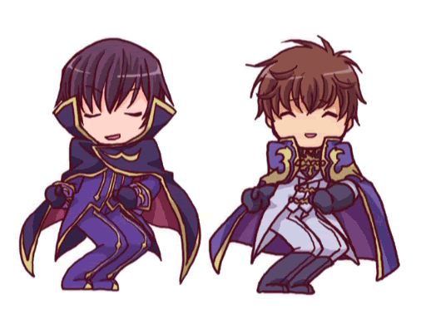
HOORAY SERVICE!
Thanks for going above and beyond in service guys, you all rock!

Slide 25


Service Concerns!
At risk-ers contacted!
If you feel like you need help with service WE ARE HERE FOR YOU!

Slide 26
Tracking!
Everything is being tracked basically daily ish!
If you see anything wrong LET US KNOW AS SOON AS POSSIBLE!
FINISH STRONG/DO AS MUCH AS YOU CAN! YAY SERVICE

Slide 27
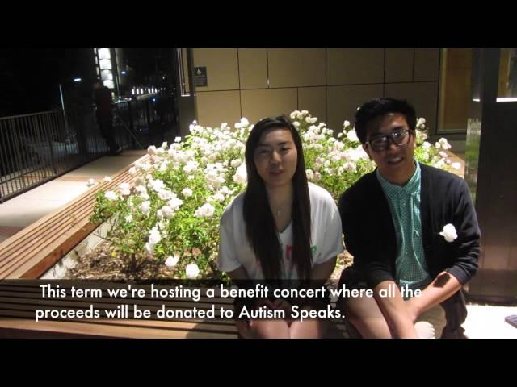

Slide 28
Pledge Parents
Sean Tran & Annie Tran
pledgeparents@apo-x.org

Slide 30
Finance VPs
Emily Neai-Proeung & Jonathan Liu
finance@apo-x.org

Slide 31

Still need Fundraising Credit?
EVENTS:
NEXT FRIDAY: TV Taping! (“Young And Hungry, CBS Studios)
PAYOFF:
$23 to pay off!
OR 1.5 * remaining fund
DUE: MAY 26th, 2014

Slide 32

Fundraising Updates!
Current Total Fundraised:
$1609.20
Closer to our goal donating to AUTISM SPEAKS :) !
Shout Out to the Pledge class!
$557.48!

Slide 33
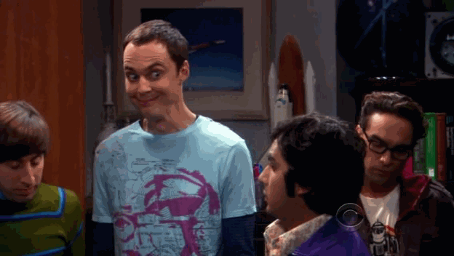
Benefit Concert!
Promote promote promote!
Group/Chapter fundraising effort!
Encourage your non APO friends/IC friends/non UCLA friends to come along too!

Slide 34
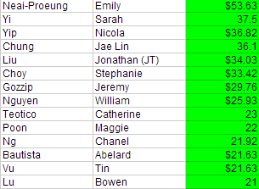

CONGRATS!!!

Slide 35
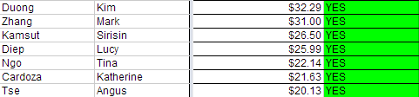
CONGRATS!!!

Slide 36


Slide 37
Fellowship VPs
Michael Hung & Dianne Pham
fellowship@apo-x.org

Slide 38

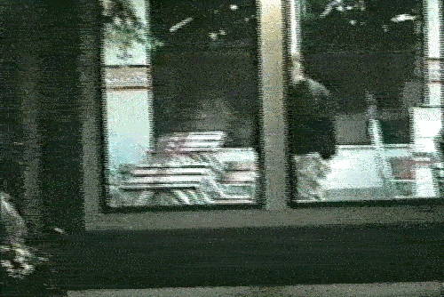
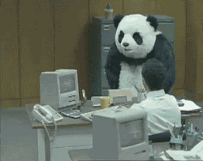
Fun Foursies!
Turn them in by NEXT MEETING (in two weeks!)
Missing it will result in a STRIKE and a NEGATIVE FELLOWSHIP CREDIT.
NO YES

Slide 39

BANQUET
Sign up! (Tri-tip or Salmon or Vegetarian!)
Los Verdes Golf Course
7000 W. Los Verdes Drive Rancho Palos Verdes, CA 90275
SIGN UP ON THE CALENDAR BY 5/19 (MONDAY).

Slide 40
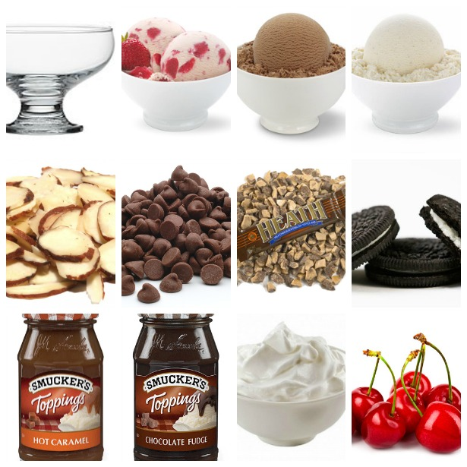
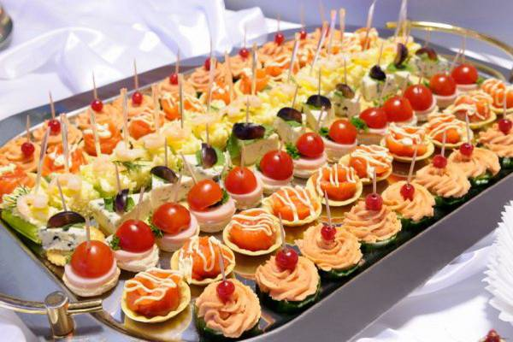
IMPORTANT
Self-service ice cream bar or hors d’oeuvres??
vs.

Slide 41
Payment
All good-standing actives and pledges are subsidized.
When can you pay? Today! Up until CM#8.
Venmo payments have until two days before CM #8.
Pay Angie, Kendrick, Trang, Yuki, or Jenny Ham
After CM#8, the price will increase by $5 (five dollars) EACH DAY.

Slide 42
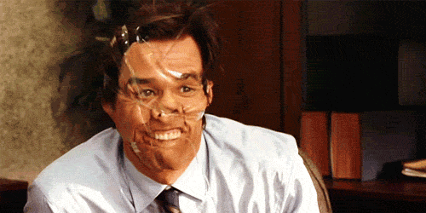
Need fellowships?
Let us know!

Slide 43

Historian
Tin Tran
historian@apo-x.org

Slide 44
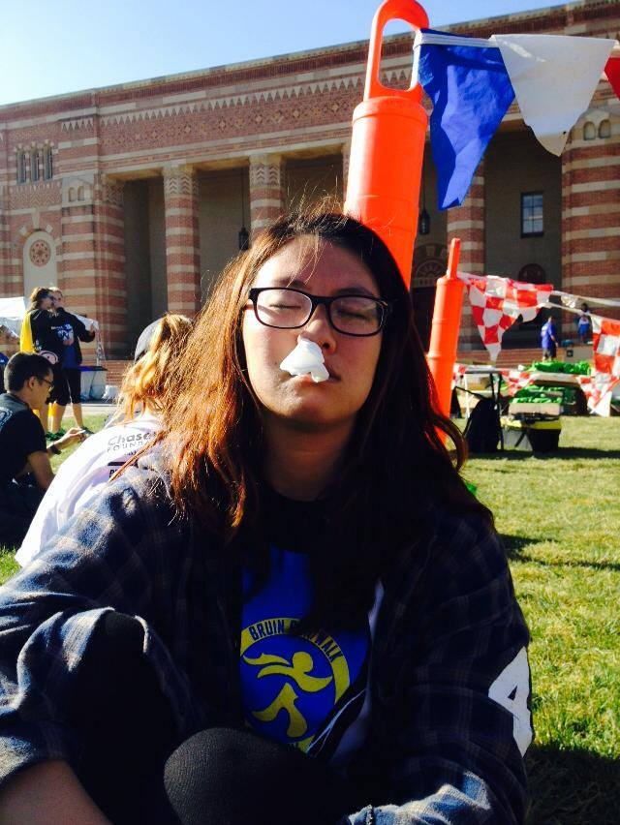
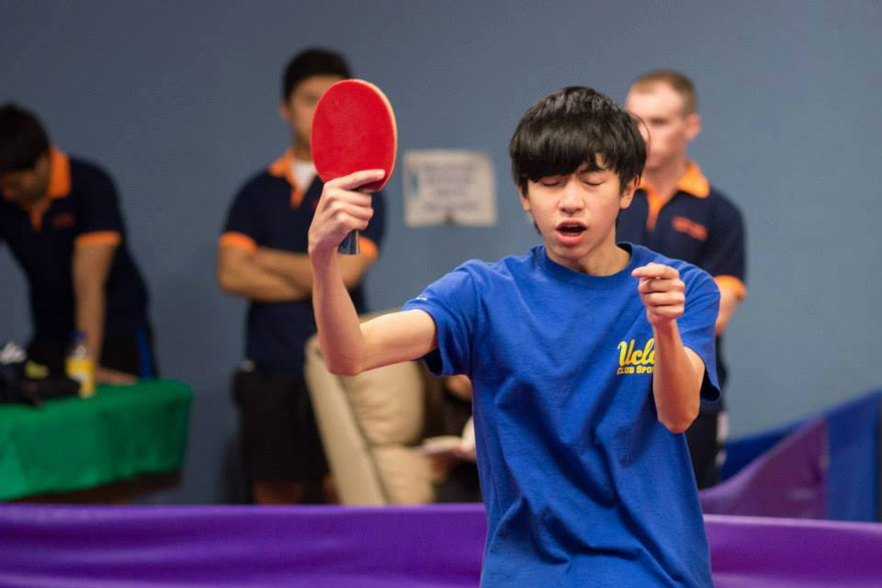
Brothers of Chi Chapter
“Ping pong ting tong ling long”
Submitted by Tin Tran
“Omg.................... WHO TOOK THIS PIC!!! I'm not gonna talk to u FOREVER!”
Submitted by Ann Dai

Slide 45

Brother of the Week #1
Bruno Mars’ Twin

Slide 46
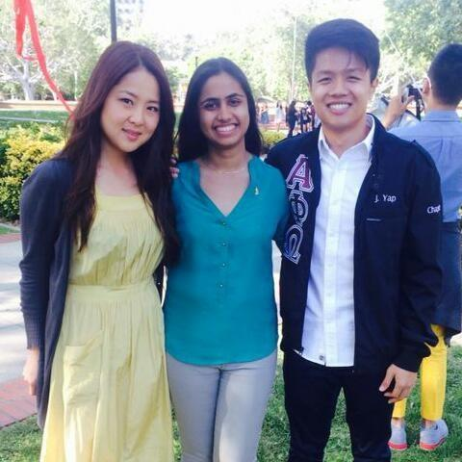
Brother of the Week #1
Jenny Ham

Slide 47

Brother of the Week #2
No guessing…
Drumroll please...

Slide 48
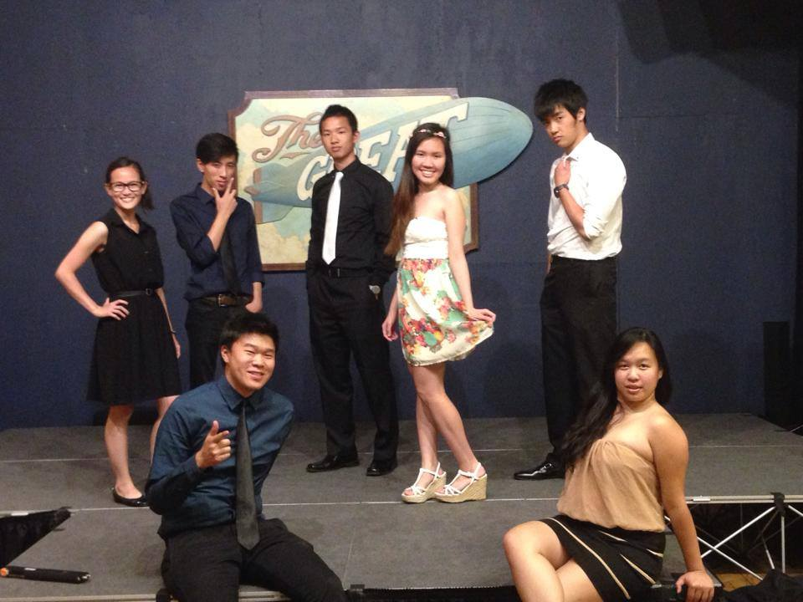
Brother of the Week #2
Fellowship committee~ yay

Slide 49

Chi Trivia
For actives
The phrase “ You don’t even know”
was coined in what term and
by who?

Slide 50
Chi Trivia
For actives
The phrase “ You don’t even know”
was coined in what term and
by who?
Alpha Iota, Joseph Chan

Slide 51

Chi Trivia
For pledges
Who started the #creeperolympics
and when did he/she pledge?

Slide 52
Chi Trivia
For pledges
Who started the #creeperolympics
and when did he/she pledge?
William Nguyen, Alpha Iota

Slide 53

Headshots
Last names A-M, who still haven’t taken it yet.
Last names through N-P
who ever wants to take it…
Only two meetings left...

Slide 54
Headshots
Chanel Ng
Samuel Nganga
Julie Nguyen
Nicole Nguyen
Jacqueline Pan
Olivia Pardo
Bryan Park
Dianne Pham
Maggie Poon
Althea Alquitran
Talia Berson
Jessica Bobis
Joseph Chan
Stephanie Choy
Anna Do
Vickie Do
Merry Fu
Jeremy Gozzip
Jessie Hsieh
Kristine Huynh
Bo Bae Jeong
Xin Jin
Linda Kang
Jenny Lam
Brian Lee
Ariel Lei
Michelle Li
Alice Lim
Tracy Lin
Roxy Luo
Vicki Luong
Hamilton Luu
Danny Ly
Melissa Ma
Raymond Mai
Yuki Nakamura
Jae-Ho Nam
Patricia Natalie
Emily Neai-Proeung

Slide 55

[YC] Chi Trivia Night
May 21st!
Don’t forget to sign up.

Slide 56
Sergeant-at-Arms
Catherine Teotico
apoxsergeant@gmail.com

Slide 57
ABC Goes To….
[This person] was a great chair. We did blogilates and she went to Wooden earlier so she could save us a room. When we started, we were all struggling and wanted to give up, but she encouraged us to keep going. She would say things like "Keep going! Don't give up, Nicola! You can do it!" And she would correct me when my form was wrong. We had a great time and laughed a lot at how much we were struggling. It was a fun event.

Slide 58
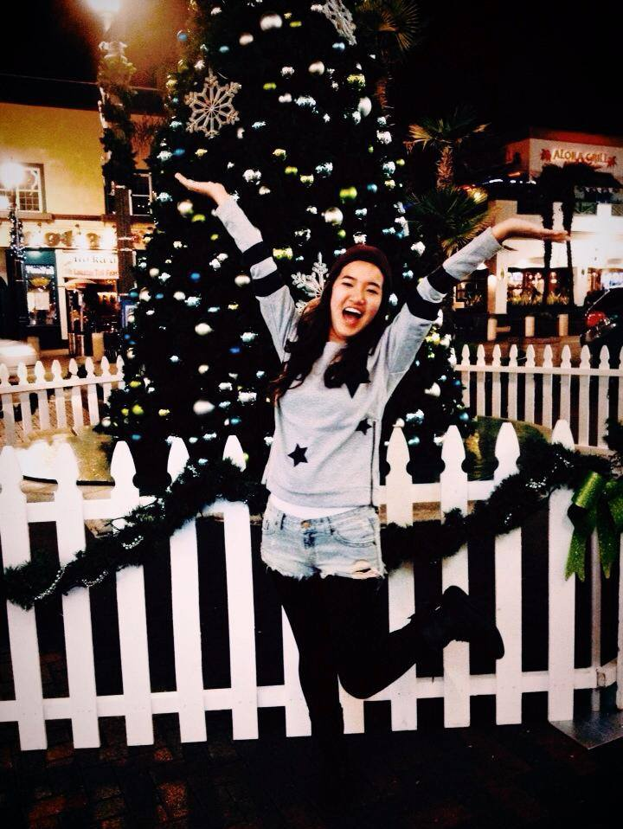

Jeesun for O-Workout!!

Slide 59
Interchapter Chair
Olivia Pardo
interchapter@apo-x.org

Slide 60


WELCOME

Slide 61
Chairman of the Advisory Committee
Kevin Lee
cac@apo-x.org

Slide 63
Nominations
President
Raymond Mai
Service VPs
Rui Guo

Slide 64
Membership VPs
Jeremy Gozzip and Andrew Suh
Pledge Parents
Brian Lee and Emily Neai-Proeung

Slide 65
Admin VPs
Nicola Yip and Kevin Quizon
Finance VPs
Jonathan Liu and Tin Vu

Slide 66
Fellowship VPs
Danny Ly and Ann Dai
Historian
Juana Li

Slide 67
SAA
Joshua Chin
IC Chair
Chanel Ng

Slide 68
CAC

Slide 69
Sectionals Chair Nominations
Jeremy Gozzip
Holly Fuong
Dianne Pham

Slide 70
